Slide 1

 | BMS INSTITUTE OF TECHNOLOGY & MANAGEMENT, YELAHANKA, BANGALORE. Department of Artificial Intelligence and Machine Learning
CROP PRODUCTION VERIFICATION
UNDER THE GUIDANCE OF:
Dr. Vishwa Kiran S
Associate Professor , AI&ML
BMSIT&M
2020-21
Akanksh Rao S. R | 1BY19AI007
Ananya S. Malagi | 1BY19AI009
Puja S. | 1BY19AI040
Siddharth Arora | 1BY19AI054

Slide 2
CONTENT
Introduction
Problem Statement
Objective
Literature Survey
Limitations of Existing Systems
Research Gap and Research Challenges
Proposed Methodology
Subject Mapping (write which subjects you can Map)
References

Slide 3
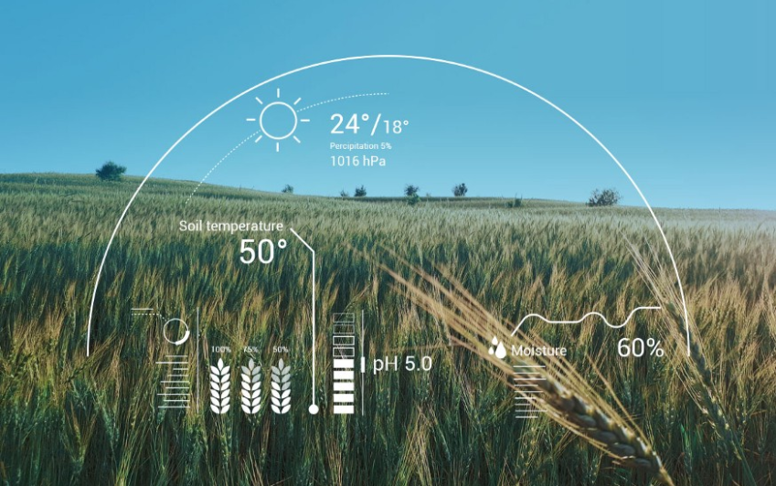

INTRODUCTION
Agriculture is the key development in the rise of sedentary human civilization. We aim to develop and implement a model based on Artificial Intelligence to make this process more efficient by helping farmers and cultivators to produce and distribute healthy crops

Slide 4
PROBLEM STATEMENT
To maintain efficient and high quality production of healthy food/ crops and to avoid diseased crop, pests and unwanted pesticides and adulterants.

Slide 5
OBJECTIVE
Modern Agriculture faces tremendous challenges. Farmers have to consider local climatic and geographic aspects as well as global ecological and political factors in order to guarantee economical survival and sustainable production.
Our objective is to provide a method to monitor crop details like Type, breed, its Health etc for planned use of resources by the farmer to maximize its development and maintain an efficient production

Slide 6
LITERATURE SURVEY
Sl.no | Research Paper | Year of Publication | Methodology
1 | Android Based Plant Disease Detection Using Arduino Veena Krishnan G N. Kumareshan | 2019 | An automated system has been developed to determine whether the plant’s leaf is healthy or disease affected.
2 | Crop detection using machine learning models Hugo crisostomo Osmar abilio | 2020 | Ground research carried out in fields of Brazil specifically Rice crop detection.

Slide 7
LITERATURE SURVEY
3 | AI and ML-Based Crop Detection Application Malathi naveen | Aug 2021 | Identification of crop using field image captured along with its geo-location using mobile camera in the absence of Internet connection.
4 | Machine Learning Based Nutrient Deficiency Detection in Crops Amritha umamaheshwari | 2020 | Designing an automatic robotic vehicle which detects the nutrient deficiency in crops by capturing the image of leaves of the crop plants.
5 | A Review of Artificial Intelligence Methods for Seed Quality Inspection Wei long Shasha | Jan 2021 | Therefore, the quality inspection method combining spectral image processing and artificial intelligence emerges and makes the quality inspection of agricultural products more automatic and intelligent.

Slide 8
LIMITATIONS OF EXISTING SYSTEMS
The limitations of technology includes:
1. Complex to develop and implement
2. Time-consuming to utilize drones when dealing with a growing crop
3. The large amount of labour required to retrieve images
4. The financial investment needed to receive results in a timely manner.
Other challenges of existing systems are:
1. Availability of dataset
2. Disease grading
3. There exists no individual crop detection monitoring system.
4. Regional variations in symptoms of diseases, accuracy and so on.

Slide 9
RESEARCH GAP
Response Time and Accuracy
Big Data Required
Higher costs of services
Unsustainable farming practices
Focus on classification than improving the performance of the soil.
Low adoption levels of emerging technologies.

Slide 10
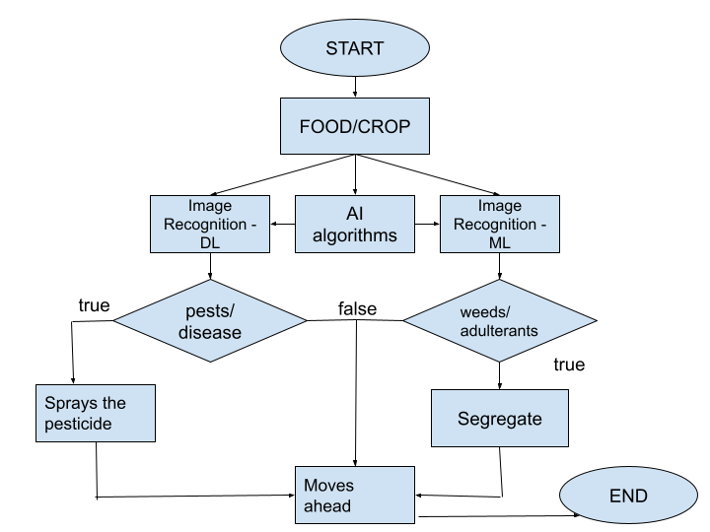
PROPOSED METHODOLOGY
Base Plan

Slide 11
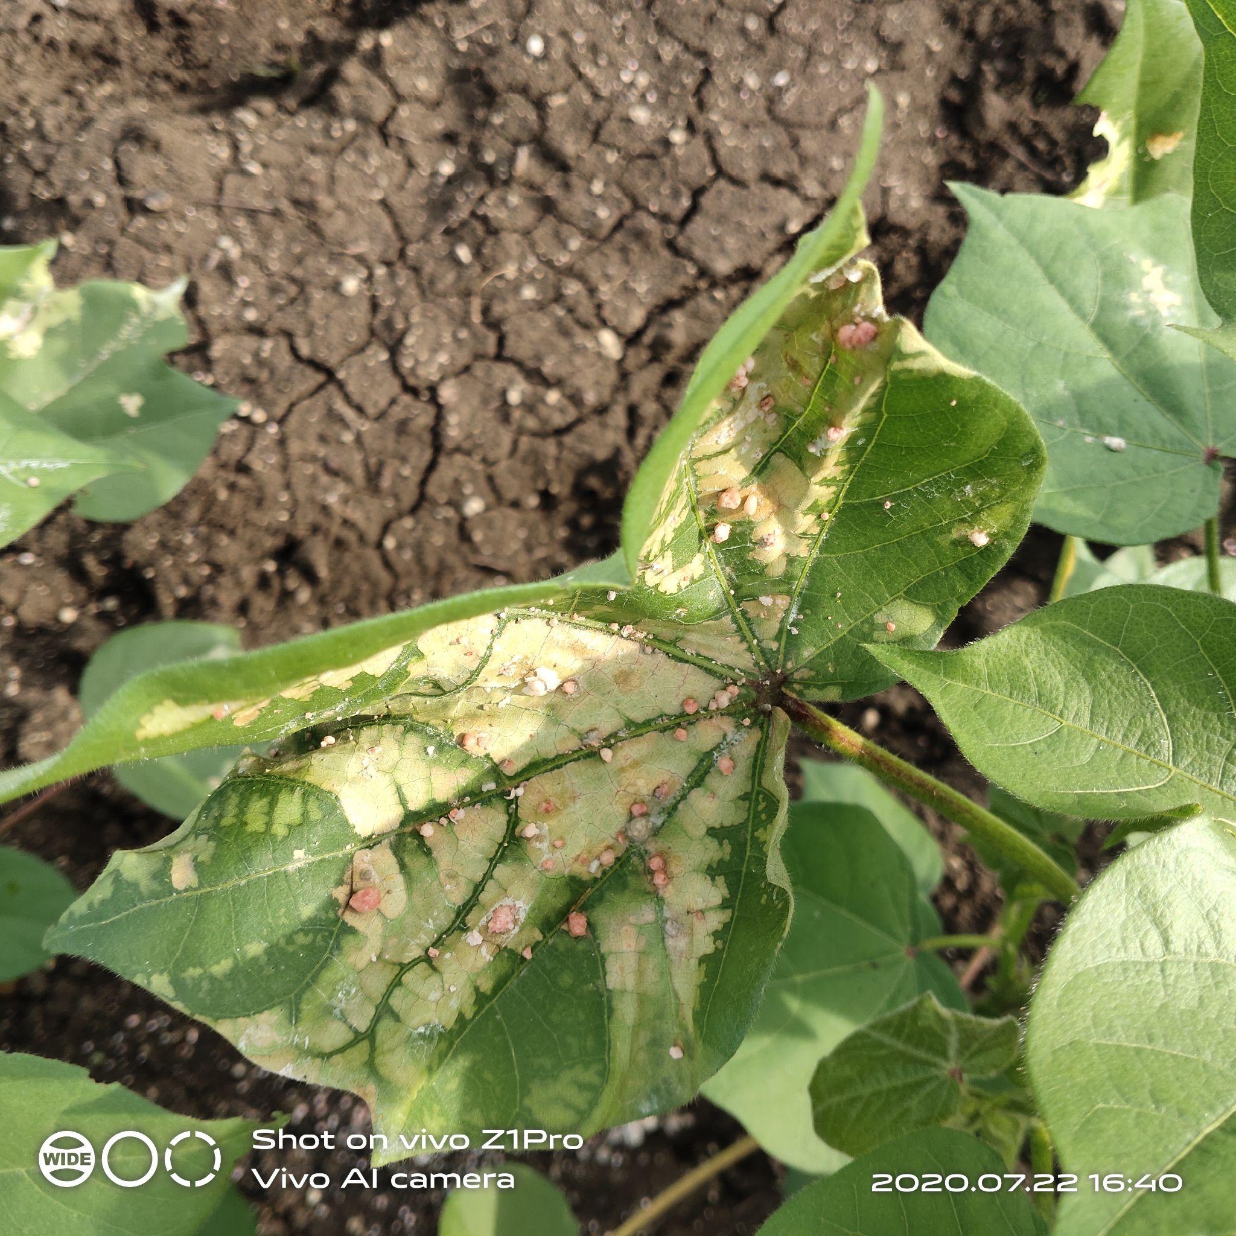
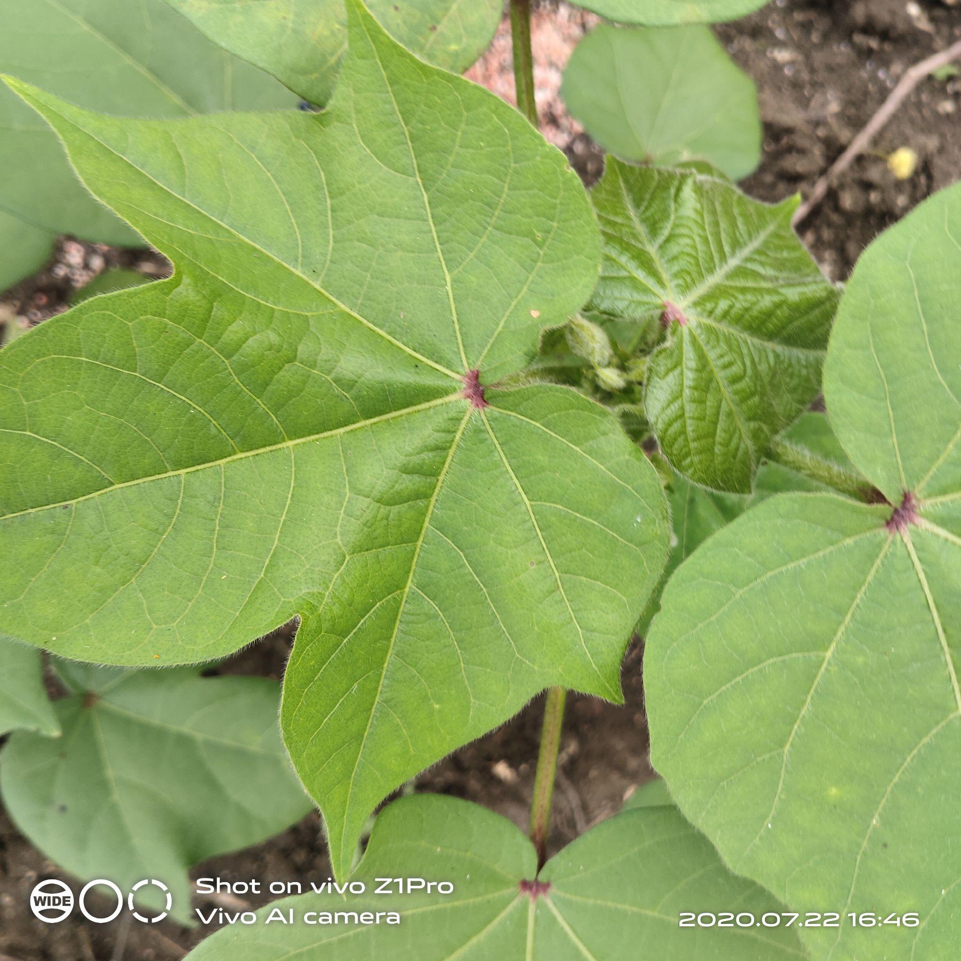
PROPOSED METHODOLOGY
Diseased Cotton leaf
Vs
Healthy Cotton leaf

Slide 12
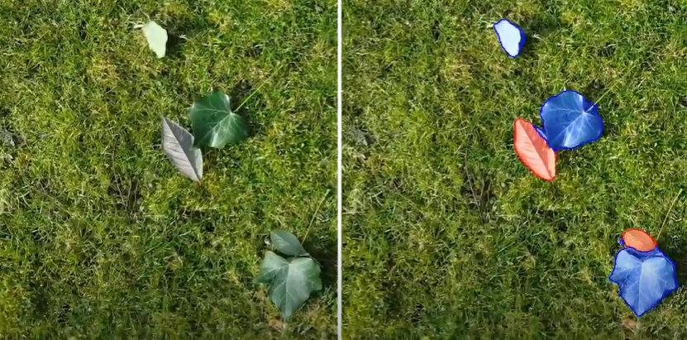
PROPOSED METHODOLOGY
original footage
Vs
AI algorithm footage

Slide 13
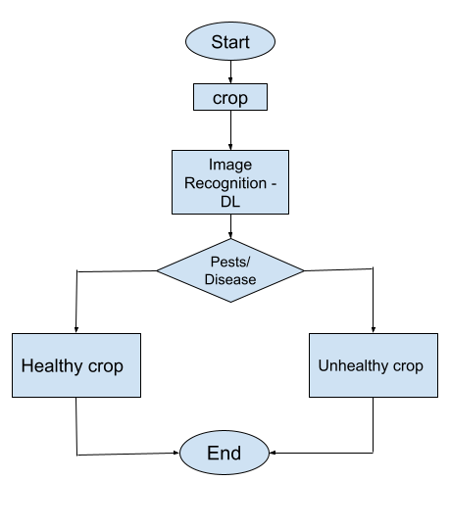
IMPLEMENTATION
Implemented portion

Slide 14
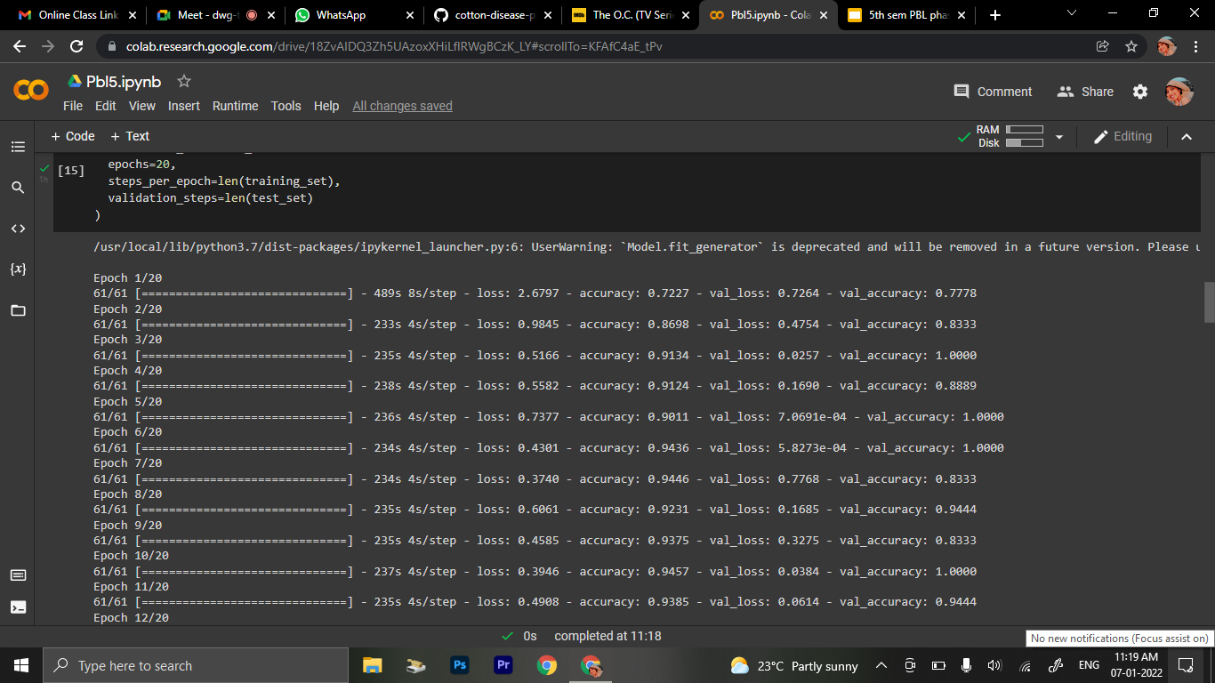
DEMO

Slide 15
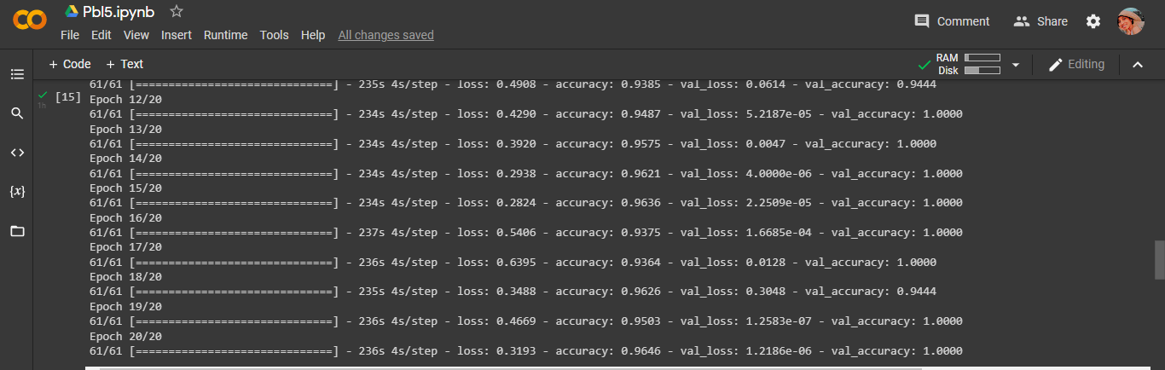
DEMO

Slide 16
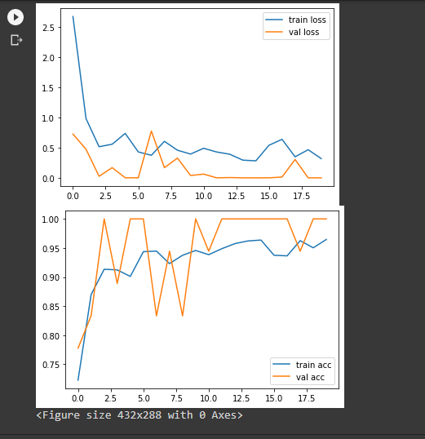
DEMO

Slide 17
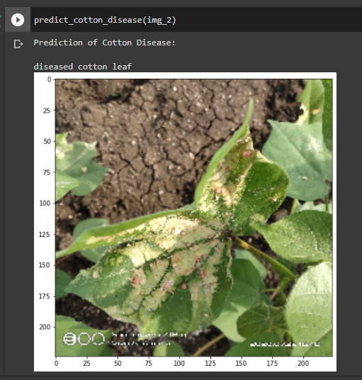
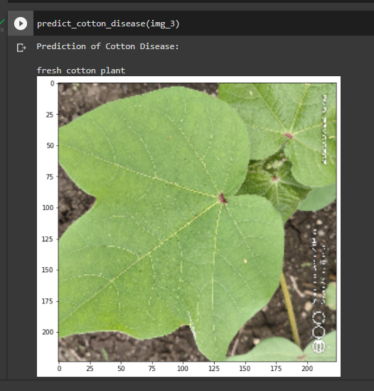
DEMO

Slide 18
FUTURE ENHANCEMENT
Includes:
1. Application development
2. Multiple crops (both food and commercial crops)
3. To be able to incorporate the soil health detection

Slide 19
SUBJECT MAPPING
SUBJECT | MAPPING
MANAGEMENT & ENTREPRENEURSHIP | Managing the group and allocation of work. Principles of Management have been put into action. And the creation or extraction of value generally entailing risk beyond what is normally encountered.
PYTHON PROGRAMMING | Project Code
MATH FOR MACHINE LEARNING | Statistical analysis and calculations performed to obtain accurate results.
ARTIFICIAL INTELLIGENCE | In order to obtain the best result (optimal) we use different search techniques and algorithms in our code.

Slide 20
REFERENCES
https://www.hindawi.com/journals/js/2018/8672769/
https://create.arduino.cc/projecthub/teamato/farmaid-plant-disease-detection-robot-55eeb1
https://www.jetir.org/papers/JETIR1905D18.pdf
https://link.springer.com/content/pdf/10.1007/s13218-013-0275-y.pdf
https://en.wikipedia.org/wiki/Applications_of_artificial_intelligence#Agriculture
https://www.bighaat.com/blogs/news/42151041-biggest-problems-faced-by-farmers-in-india
https://blog.apnikheti.com/agriculture-problems-and-their-solutions/

Slide 21
THANK YOU

